Slide 1
Design for Operations
1. Design a monitoring strategy
Identify the Microsoft products and services for monitoring Azure solutions
leverage the capabilities of Azure Operations Management Suite and Azure Application Insights for monitoring Azure solutions
leverage built-in Azure capabilities
identify third-party monitoring tools, including open source
describe Azure architecture constructs, such as availability sets and update domains, and how they impact a patching strategy
analyze logs by using the Azure Operations Management Suite
4. Design Azure Automation and PowerShell workflows
Create a PowerShell script specific to Azure, automate tasks by using the Azure Operations Management Suite
2. Describe Azure business continuity/disaster recovery (BC/DR) capabilities
Leverage the architectural capabilities of BC/DR
describe Hyper-V Replica and Azure Site Recovery (ASR)
describe use cases for Hyper-V Replica and ASR
3. Design a disaster recovery strategy
Design and deploy Azure Backup and other Microsoft backup solutions for Azure
leverage use cases when StorSimple and System Center Data Protection Manager would be appropriate
design and deploy Azure Site recovery
5. Describe the use cases for Azure Automation configuration
Evaluate when to use Azure Automation, Chef, Puppet, PowerShell, or Desired State Configuration (DSC)

Slide 2
6.1 Monitoring Strategy
What Architects Need to Know

Slide 3
6.1 Design a monitoring strategy
Identify the Microsoft products and services for monitoring Azure solutions
leverage the capabilities of Azure Operations Management Suite and Azure Application Insights for monitoring Azure solutions
leverage built-in Azure capabilities
identify third-party monitoring tools, including open source
describe Azure architecture constructs, such as availability sets and update domains, and how they impact a patching strategy
analyze logs by using the Azure Operations Management Suite

Slide 4
6.1.1 Identify the Microsoft products and services for monitoring Azure Solutions
System Center
Configuration Manger – Client Device and Application Management
Operations Manager – Monitoring and Alerting
Virtual Machine Manager – DataCenter Mgt
Data Protection Manager – Backup and Disaster Recovery
Orchestrator – Workflow Engine
Azure Portal / Built-in Capabilities - Diagnostic Monitor
Global Service Monitor
Application Insights
Operations Management Suite

Slide 5
Design a Monitoring Strategy
Built-in Abilities
Diagnostic Monitor:
Web & Worker Roles
Global Service Manager
System Center Capabilities
Management Packs: Azure, Azure SQL, SQL
Third Party Tools
Open Source
Ops Manager, Application Insights (VSO) – Telemetry Data
Use Cases for WSUS
Config Manager
Custom Solutions
Architecture Constructs: Availability Groups and Update Domains

Slide 6
Global Services Monitor
Monitors web applications in internal and external locations
Create synthetic transactions used to simulate remote user traffic from a specific global location
Monitor web apps from 16 locations
Integrates with SCOM 2012
Notes:
System Center Global Service Monitor is a cloud service that provides a simplified way to monitor the availability of external-web-based applications from multiple locations around the world.
Importantly, Global Service Monitor monitors applications from the perspective of the customers who use them.
Because Global Service Monitor monitors from locations that are correlated to customer geographies, application owners can gain insight into customer experiences in addition to the separate problems related to external factors, such as Internet or network problems, from application or service problems.
The Global Service Monitor monitoring experience focuses on the application instead of the infrastructure or individual URL.
The Operations Manager console integration lets you monitor web applications from both internal and external locations
GSM lets you monitor web applications from 16 locations and then report back to your management group.
A maximum number of tests for the two monitoring types
These are the Web Application Availability monitoring that monitors single URLs, and Visual Studio Web Tests monitoring
https://technet.microsoft.com/en-us/library/jj860368.aspx

Slide 7
Application Insights
Detect and diagnose issues in Web apps and services
Alerts through email or webhooks
Diagnose exceptions and performance issues
Perform root cause analysis and initiate azure automation runbook
Live application monitoring
HTTP metrics, Dependency (SQL) response times, Log tracing, View and Session counts, Server performance, Availability tests
Notes:
Application Insights is an extensible Application Performance Management (APM) service for web developers on multiple platforms.
Use it to monitor your live web application. It will automatically detect performance anomalies.
It includes powerful analytics tools to help you diagnose issues and to understand what users actually do with your app.
It's designed to help you continuously improve performance and usability. It works for apps on a wide variety of platforms including .NET, Node.js and J2EE, hosted on-premises or in the cloud. It integrates with your devOps process, and has connection points to a variety of development tools.
Request rates, response times, and failure rates
Performance counters from your Windows or Linux server machines, such as CPU, memory, and network usage.
Page views and load performance - reported by your users' browsers.
Dependency rates, response times, and failure rates - Find out whether external services are slowing you down.
https://docs.microsoft.com/en-us/azure/application-insights/app-insights-overview

Slide 8
Operations Management Suite
OMS has the following functionality:
Log Analysis
Connect VMs to OMS using portal, powershell, CLI, or ARM Templates
Can read from Azure storage and diagnostic logs
Automation
Azure automation runbooks
Disaster Recovery
Azure Backup and Site Recovery
Security and Compliance
Analyzes security events
Notes:
Operations Management Suite (also known as OMS) is a collection of management services that were designed in the cloud from the start.
Rather than deploying and managing on-premise resources, OMS components are entirely hosted in Azure.
Configuration is minimal, and you can be up and running literally in a matter of minutes.+
Minimal cost and complexity of deployment. Because all of the components and data for OMS are stored in Azure, you can be up and running in a short time without the complexity and investment in on-premise components.
Scale to cloud levels. You don’t have to worry about paying for compute resources that you don’t need or about running out of storage space since the cloud allows you to pay only for what you actually use and will readily scale to any load you require. You can start by managing a few resources to get started and then scale up to your entire environment.
Take advantage of the latest features. Features in OMS services are continuously being added and updated. You constantly have access to the latest features without any requirement to deploy updates. [Talk about Big Data here and it can improve the monitoring]
Integrated services. While each of the OMS services provide significant value on their own, they can work together to solve complex management scenarios. For example, a runbook in Azure Automation might drive a failover process with Azure Site Recovery and then log information to Log Analytics to generate an alert.
Global knowledge. Management solutions in OMS continuously have access to the latest information. The Security and Audit solution for example, can perform a threat analysis using the latest threats being detected around the world.
Access from anywhere. Access your management environment from anywhere you have a browser. Install the OMS app on your smartphone for ready access to your monitoring data.
https://docs.microsoft.com/en-us/azure/operations-management-suite/operations-management-suite-overview

Slide 9
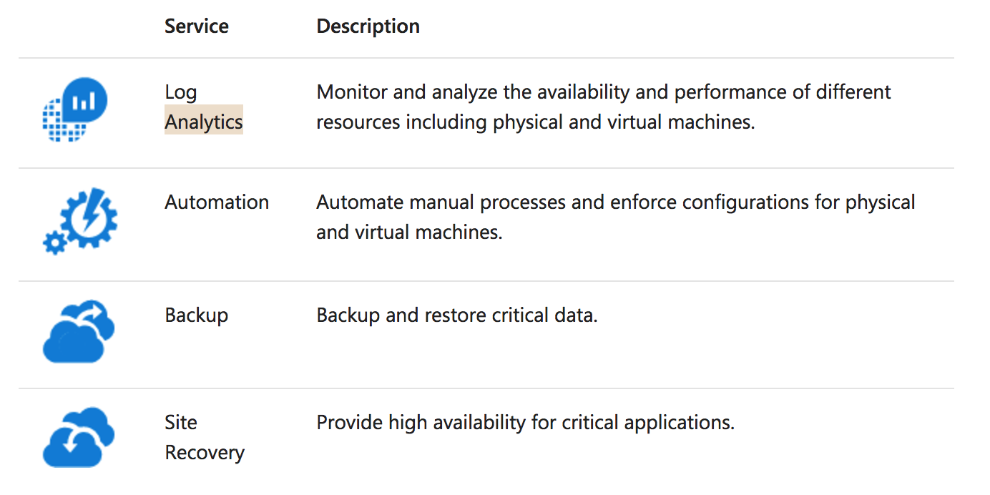
OMS Services
Notes:
The core functionality of OMS is provided by a set of services that run in Azure.
Each service provides a specific management function, and you can combine services to achieve different management scenarios
https://docs.microsoft.com/en-us/azure/operations-management-suite/operations-management-suite-overview

Slide 10
OMS Services – Log Analytics
Notes:
Log Analytics provides monitoring services for OMS by collecting data from managed resources into a central repository.
This data could include events, performance data, or custom data provided through the API.
Once collected, the data is available for alerting, analysis, and export.
This method allows you to consolidate data from a variety of sources so you can combine data from your Azure services with your existing on-premises environment.
It also clearly separates the collection of the data from the action taken on that data so that all actions are available to all kinds of data
Windows and Linux
You install the Microsoft Monitoring Agent on Windows and Linux computers or virtual machines that you want to collect data from.
Azure services. Log Analytics collects telemetry from Azure Diagnostics and Azure Monitoring into the repository so that you can monitor Azure resources.
Data Collector API. Log Analytics has a REST API for populating data from any client.
Solution Packs
AD Replication Health Solution Packs, AD Replication Solution Pack, Over network health. Tons of 3rd party tool
Views and dashboards – output
Power BI- you can export to Power BI
Log Search API. – to export to 3rd part tool
https://docs.microsoft.com/en-us/azure/operations-management-suite/operations-management-suite-overview

Slide 11
OMS Services – Log Analytics
SQL Analytics
DNS Analytics
WebApp Analytics
AD Assessment
AD Replication Status
Change Tracking
Notes:
https://docs.microsoft.com/en-us/azure/log-analytics/log-analytics-azure-sql

Slide 12
Demo
Create an OMS Workspace and Use Log Analytics
https://docs.microsoft.com/en-us/azure/log-analytics/log-analytics-quick-collect-azurevm

Slide 13
OMS Services – Process Automation
Notes:
Hybrid
Resources in your data center most likely cannot be accessed from a runbook running in the cloud.
You can install one or more Hybrid Runbook Workers (HRW) in your data center
When runbooks run in the cloud, they can access any resources accessible from the cloud.
This could be resources in your Azure subscription, in another cloud such as Amazon Web Services (AWS), or a service accessible through a REST API.
https://docs.microsoft.com/en-us/azure/operations-management-suite/operations-management-suite-overview

Slide 14
OMS Services – Security And Compliance
The OMS Security and Audit dashboard is organized in four major categories:
Security Domains
Notable Issues
Detection (Preview)
Threat Intelligence
Common security queries
Notes:
Hybrid
Resources in your data center most likely cannot be accessed from a runbook running in the cloud.
You can install one or more Hybrid Runbook Workers (HRW) in your data center
When runbooks run in the cloud, they can access any resources accessible from the cloud.
This could be resources in your Azure subscription, in another cloud such as Amazon Web Services (AWS), or a service accessible through a REST API.
https://docs.microsoft.com/en-us/azure/operations-management-suite/operations-management-suite-overview

Slide 15
System Center for Azure Overview
Deploy on-premises typically or Azure VMs
On-premises can monitor Azure VMs
Site-to-Site VPN/Express Route
Gateway Server
Domain Joined Machines or Certificate based Auth for non-domain
Notes:
Operations Manager, a component of Microsoft System Center 2016, is software that helps you monitor services, devices, and operations for many computers from a single console.
This topic explains basic concepts about Operations Manager for the administrator who manages the Operations Manager infrastructure and the operator who monitors and supports the IT services for your business.
https://docs.microsoft.com/en-us/system-center/scom/key-concepts

Slide 16
Operations Manager for Azure
Use Azure Management Pack to monitor Azure Subscriptions
Availability and performance of resources in Azure
Automatically discovers and starts collection of performance/monitoring data in Azure for cloud services, storage, VMs, Azure SQL, and Web Apps
Hybrid allows for monitoring of both on-premises and Azure.
Pay for bandwidth out of Azure
Notes:
For hybrid solutions review: https://docs.microsoft.com/en-us/system-center/scom/deploy-install-gateway-server
Gateway servers are used to enable agent-management of computers that are outside the Kerberos trust boundary of management groups, such as in a domain that is not trusted.
The gateway server acts as a concentration point for agent-to-management server communication. Agents in domains that are not trusted communicate with the gateway server and the gateway server communicates with one or more management servers. Because communication between the gateway server and the management servers occurs over only one port (TCP 5723), that port is the only one that has to be opened on any intervening firewalls to enable management of multiple agent-managed computers. Multiple gateway servers can be placed in a single domain so that the agents can failover from one to the other if they lose communication with one of the gateway servers.
Similarly, a single gateway server can be configured to failover between management servers so that no single point of failure exists in the communication chain.

Slide 17
Azure Monitoring Strategies
Azure Monitor
Application Insights
Log Analytics
Notes:
There is a range of tools for monitoring Azure applications and services. Some of their features overlap. This is partly for historical reasons and partly due to the blurring between development and operation of an application.
Here are the principal tools:
Azure Monitor is basic tool for monitoring services running on Azure. It gives you infrastructure-level data about the throughput of a service and the surrounding environment. If you are managing your apps all in Azure, deciding whether to scale up or down resources, then Azure Monitor gives you what you use to start.
Application Insights can be used for development and as a production monitoring solution. It works by installing a package into your app, and so gives you a more internal view of what’s going on. Its data includes response times of dependencies, exception traces, debugging snapshots, execution profiles. It provides powerful smart tools for analyzing all this telemetry both to help you debug an app and to help you understand what users are doing with it. You can tell whether a spike in response times is due to something in an app, or some external resourcing issue. If you use Visual Studio and the app is at fault, you can be taken right to the problem line(s) of code so you can fix it.
Log Analytics is for those who need to tune performance and plan maintenance on applications running in production. It is based in Azure. It collects and aggregates data from many sources, though with a delay of 10 to 15 minutes. It provides a holistic IT management solution for Azure, on-premises, and third-party cloud-based infrastructure (such as Amazon Web Services). It provides richer tools to analyze data across more sources, allows complex queries across all logs, and can proactively alert on specified conditions. You can even collect custom data into its central repository so can query and visualize it.
System Center Operations Manager (SCOM) is for managing and monitoring large cloud installations. You might be already familiar with it as a management tool for on-premises Windows Sever and Hyper-V based-clouds, but it can also integrate with and manage Azure apps. Among other things, it can install Application Insights on existing live apps. If an app goes down, it tells you in seconds. Note that Log Analytics does not replace SCOM. It works well in conjunction with it.
https://docs.microsoft.com/en-us/azure/monitoring-and-diagnostics/monitoring-overview

Slide 18
Azure Monitoring
Use Azure Portal to monitor Web Apps, VMs by default.
Good Short term solution for point-in-time view
Monitoring writes data to Azure Storage
Can view in Visual Studio
Configure Alerts from the portal based on performance metrics
Notes:
Azure Monitor provides base level infrastructure metrics and logs for most services in Microsoft Azure. Azure services that do not yet put their data into Azure Monitor will in the future.+
Microsoft ships additional products and services that provide additional monitoring capabilities for developers, DevOps, or IT Ops that also have on-premises installations. For an overview and understanding of how these different products and services work together
https://docs.microsoft.com/en-us/azure/monitoring-and-diagnostics/monitoring-overview-azure-monitor
The Service Level Agreement (SLA) describes Microsoft’s commitments for uptime and connectivity.
https://azure.microsoft.com/en-us/support/legal/sla/summary/

Slide 19
Availability Sets
Availability sets provide redundancy to your application.
Must contain the same OS and VM size
Used to configure Fault/Update domains
If using managed disks, must use a managed availability set
Notes:
In Azure, virtual machines (VMs) can be placed in to a logical grouping called an availability set.
When you create VMs within an availability set, the Azure platform distributes the placement of those VMs across the underlying infrastructure.
Should there be a planned maintenance event to the Azure platform or an underlying hardware / infrastructure fault, the use of availability sets ensures that at least one VM remains running.
https://docs.microsoft.com/en-us/azure/virtual-machines/windows/infrastructure-availability-sets-guidelines

Slide 20
Fault Domains & Update Domains
Fault domains define the group of virtual machines that share a common power source and network switch.
Update domains indicate groups of virtual machines and underlying physical hardware that can be rebooted at the same time.
Notes:
Each virtual machine in your availability set is assigned an update domain and a fault domain by the underlying Azure platform.
For a given availability set, five non-user-configurable update domains are assigned by default (Resource Manager deployments can then be increased to provide up to 20 update domains) to indicate groups of virtual machines and underlying physical hardware that can be rebooted at the same time.
When more than five virtual machines are configured within a single availability set, the sixth virtual machine is placed into the same update domain as the first virtual machine, the seventh in the same update domain as the second virtual machine, and so on.
The order of update domains being rebooted may not proceed sequentially during planned maintenance, but only one update domain is rebooted at a time.
https://docs.microsoft.com/en-us/azure/virtual-machines/windows/manage-availability#configure-multiple-virtual-machines-in-an-availability-set-for-redundancy

Slide 21
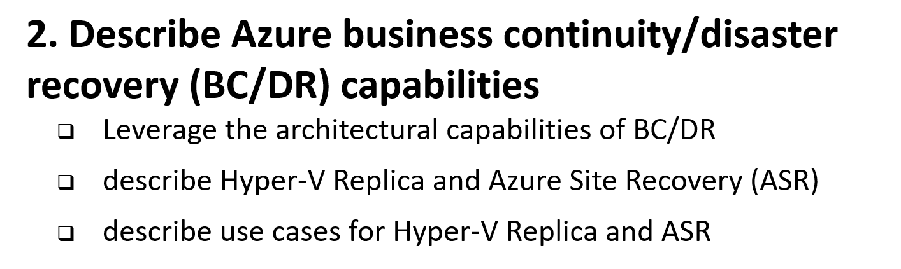
6 Manage, Monitory, Business Continuity

Slide 22
Architectural capabilities of Business Continuity /Disaster Recovery
Primary site
Primary site
Secondary site
Original
Backup
DATA
DATA
High availability
Disaster recovery
Backup
When your applications have a catastrophic failure, run a second instance
When your applications have a catastrophic failure, run them in Azure or a secondary datacenter
When your data is corrupted, deleted or lost you can restore it
Notes:
Now let’s make sure we are using the same terminology for the various parts of a business continuity strategy.
HA is
DR is
Backup is
I’m going to focus on Backup and DR.

Slide 23
RPO “Recover Point Objective” & RTO “Recover Time Objective are time intervals, typically expressed in number of hours
RPO is the maximum targeted time that data can be lost (in time)—it is the amount of time between backup, replication, or synchronization. It answers the question, “What is an acceptable amount of data loss?” It is usually much smaller than RTO.
RTO is how long it takes (in time) to restore services after a disaster. It answers the question, “How long will it take to get service back up?”
Notes:
Read word by word.
It 80% of the exam

Slide 24
Architectural capabilities of BC/DR
Recovery Point Objective (RPO) and Recovery Time Objective (RTO)
Drivers of solution cost
Minimal data loss
Reduce downtime
Availability: Storage redundancy & SLAs
Blob storage: (LRS, GRS, RA-GRS), SLAs
Synchronous vs asynchronous (how data is written)
SQL Server Always On Availability Groups (replication for availability)
Network connectivity
Application connectivity post failover
IP management
Load balancers
Notes:
RPO is the amount of data that can be lost (in time)—it is the amount of time between backup, replication, or synchronization. It answers the question, “What is an acceptable amount of data loss?” It is usually much smaller than RTO.
RTO is how long it takes to restore services after a disaster. It answers the question, “How long will it take to get service back up?”

Slide 25
What is Business Continuity and Disaster Recovery (BC/DR)
Business Continuity (BC)
Disaster Recovery (DR)
Planning and preparation to ensure that the business can continue to operate (in a reasonable amount of time) after a disaster or serious business disruptive event.
Preventing or minimizing impact of a disaster or service disruptor event
Key Elements:
Resiliency – Keep running in case of failure
Recover – Recover or restore business functions that fail
Contingency - Plans in place in case an event happens. and is not covered by Resiliency or Recovery.
Business Continuity often deals with more than just technology. (eg. Plan for critical person/people that leave the company). This element not likely on the exam, but it does matter when you architect solutions in real life. If you have read “The Phoenix Project” it would be Brent!
Creating policies and processes to quickly restore services, data, and systems to full functionality
Recovering from a Disaster after it happens. It is often linked to Business Continuity as it is a subset of the Business Continuity plan.
Key Elements:
Availability, High Availability
Urgency to getting systems up and to what % of service.
Cost vs Time vs Risk
Hot/Worm/Cold site
Recovery as a Service (RaaS)
Disaster Recovery as a Service (DRaaS)

Slide 26
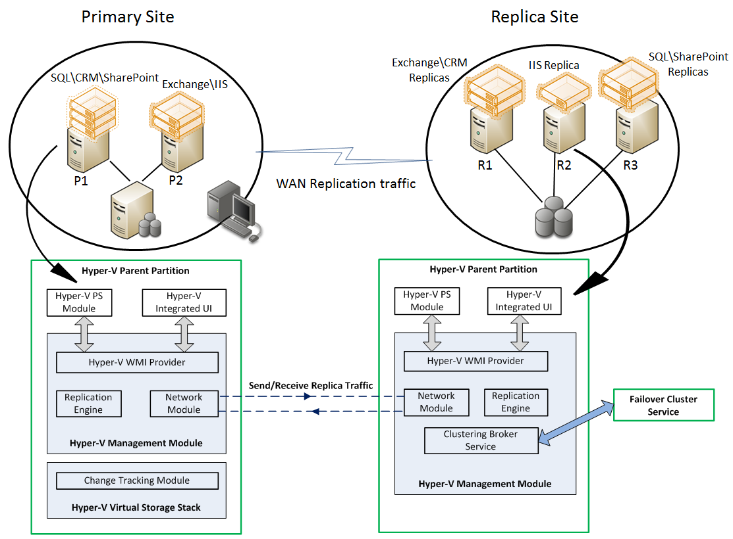
Hyper-V Replica
Asynchronous replication of VM changes (enable on primary and replica site)
Replication is on a per VM basis over HTTP
Supports planned failovers, test failovers, unplanned failovers
No shared storage or external replication technologies required
WHEN NOT
Workload requires synchronous replication, data outside of VHD
Workload needs to recover physical servers, beyond Hyper-V replica’s capabilities

Slide 27
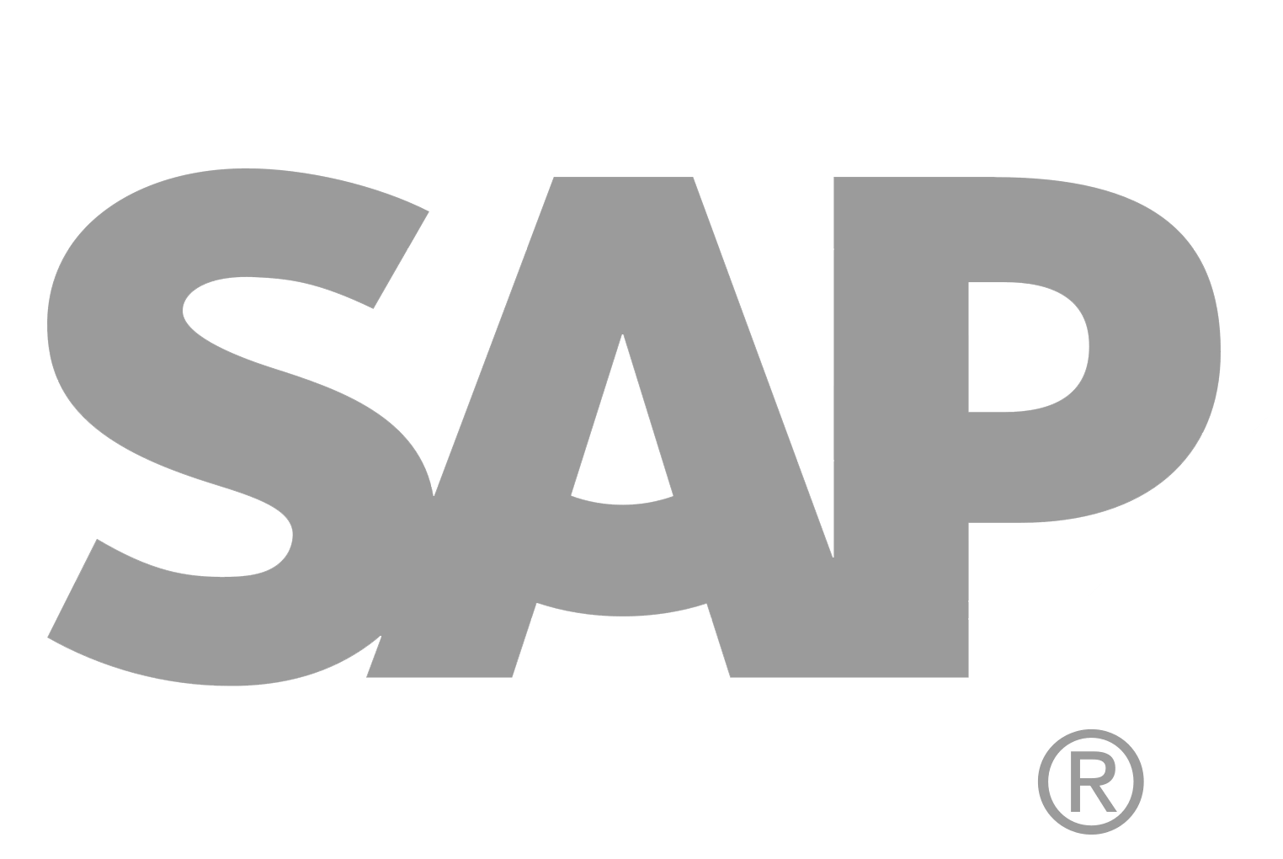
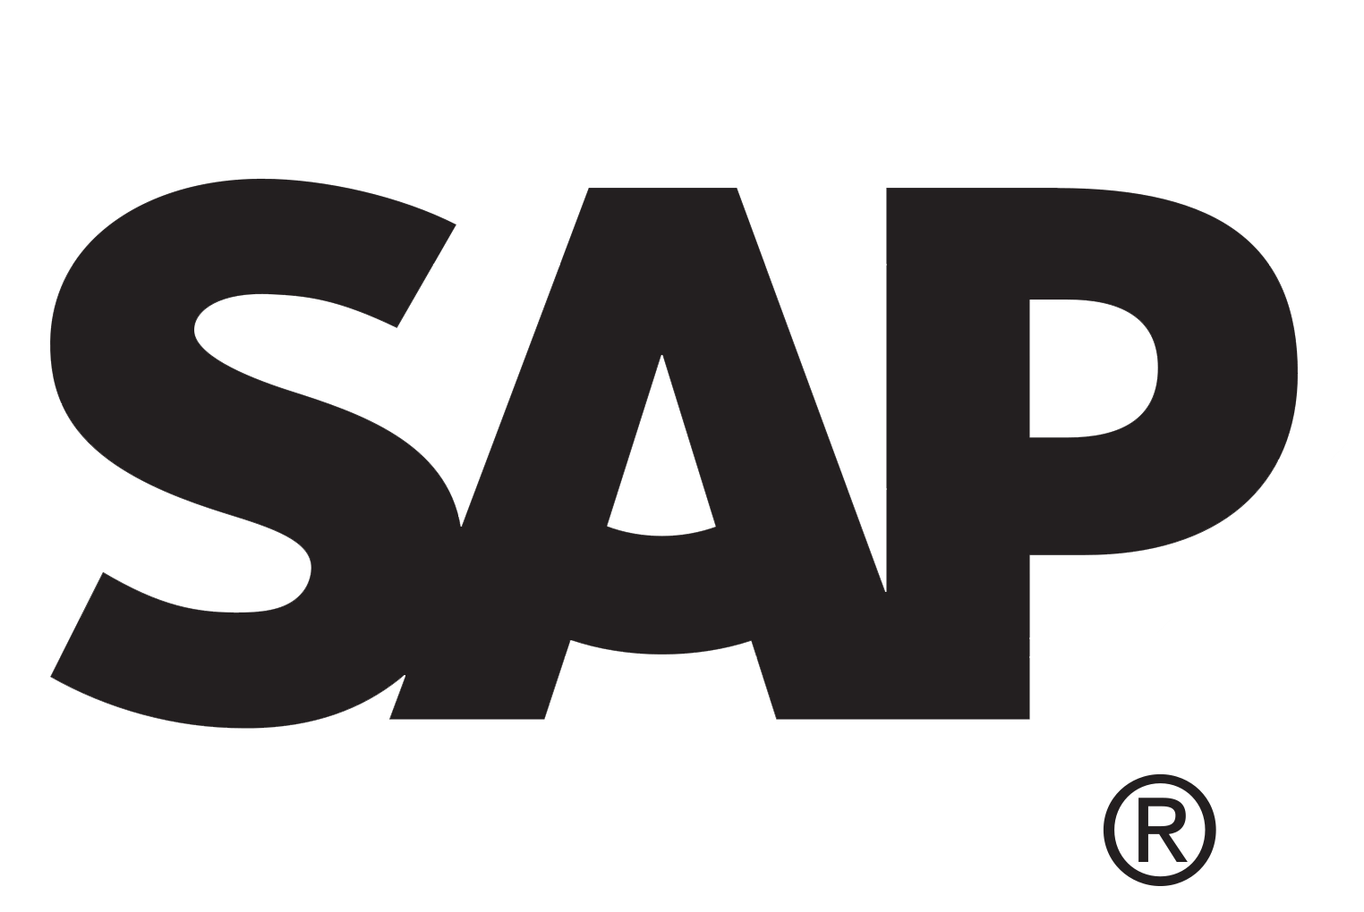
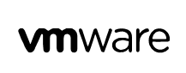
Azure Site Recovery
Azure
Automated, seamless disaster recovery from the cloud to protect applications
Provides application-consistent recovery of critical workloads
Leverage current investments
Orchestrate one-click recovery even for complex multi-tier applications
On premises VM replication to Azure or secondary on-prem datacenter
Disaster recover from primary to secondary region
Exchange
SAP
Production Environment
SharePoint
App n
Automated
Policy-based
Orchestrated
Encrypted
VPN
ExpressRoute
Downtime
Exchange
SAP
SharePoint
App n
Production Environment
Hyper-V
Bare metal
On-premises/cloud Datacenter

Slide 28
Azure BC/DR Capabilities & Use Cases
Hyper-V Replica
Simple, Affordable Second Site
“Extended Replication” + 3rd Party Integration
Hardware Agnostic – either side
Hybrid Cloud
Seamless Integration:
Private Cloud or on-premises to…
Service Provider Cloud
Microsoft Azure
Azure Site Recovery (ASR)
WHEN TO USE: 2nd Site / Use SCCM,SCVMM, Unprotected workloads
WHEN NOT TO USE:
Workload requires synchronous replication, data outside of VHD
Workload needs to recover physical servers, beyond Hyper-V replica’s capabilities

Slide 29
Sharding is when you split a database and partition the different parts of the database across multiple drives. A shard is a single horizontal partition of the database.
Notes:
Large table
Just SQL Database table into small
A to D in one database
E to G in another DB
They should be pulled together
You can setup the large database per day basis or per week depending on it.
Existing application can’t be move to sharding. You will have re write the code into the application. Use different API. It is ane xtra work. For scaling point is it amazing. It is only for Relational Database. RDBMS

Slide 30
Data Protection Manager & Azure Backup
DPM will backup more workloads
SQL, Exchange, SharePoint
DPM is deployed on-premises as a physical server or virtual machine—If you deploy DPM as a physical server or as an on-premises Hyper-V virtual machine you can back up data with Azure Backup in addition to backing data up to disk and tape.
Azure Backup provides a simple method of offsite storage. You can store data with Azure up to 3360 days
DPM is deployed as a virtual machine in Azure—If DPM is deployed as an Azure virtual machine (possible from System Center 2012 R2 with Update 3 or later) you can back up data to Azure disks attached to the DPM Azure virtual machine and then offload data storage with backup to Azure Backup.
You can offload storage to Azure Backup from the Azure disk, allowing you to scale up by storing older data in Azure Backup and new data on disk
https://technet.microsoft.com/en-us/library/jj728752(v=sc.12).aspx

Slide 31
Azure Backup Key Workloads
Specialized Workloads
File/Folders/Volumes
Virtual Machines
Exchange
SharePoint
SQL Server
Windows Server
Windows
Windows
Linux
Hyper-V
Windows Server
Microsoft Azure
VMware
Notes:
1.
Workload: Files and folders
Source Machine: Windows Server or Windows Client
Azure Backup Solutions:
Azure Backup agent,
System Center DPM (+ the Azure Backup agent),
Azure Backup Server (includes the Azure Backup agent)
2.
Workload: Hyper-V virtual machine (Win & Linux), VMWare Virtual Machine (Win & Linux), Microsoft SQL Server, Microsoft SharePoint, Microsoft Exchange
Source Machine: Windows Server
Azure Backup Solution: System Center DPM (+ the Azure Backup agent); Azure Backup Server (includes the Azure Backup agent)
3.
Workload: Azure IaaS VMs (Windows) and Azure IaaS VMs (Linux)
Source Machine: N/A
Azure Backup Solution: Azure Backup (VM extension)

Slide 32
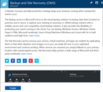
How It Works: Azure Backup Server
2. Register and configure Vault
1. Create Backup and Site Recovery Vault
3. Install Azure Backup Server software
4. Schedule & Back up encrypted data
Azure Backup Windows Server/Client
5. Recover to the same or a different server; On-Premisis or Azure VM
Step-By-Step
https://docs.microsoft.com/en-us/azure/backup/backup-try-azure-backup-in-10-mins
Notes:
Sign Up at the Azure portal
Install Azure Backup Server software
Register and configure
Back up encrypted data
Anytime the data leaves your boundary, it is encrypted. You have the passwords and keys and it’s always restored in Azure.
Recover to the same or a different server

Slide 33
Microsoft Azure Backup Server v2
Protect application workloads:
Hyper-V VMs, Microsoft SQL Server, SharePoint Server, Microsoft Exchange and Windows clients
Backup To:
Disk (D2D), giving high RTOs for tier 1 workloads
Azure (D2D2C) for long term retention
Modern Backup Storage technology (MABS v2) store backups:
Using Resilient File System (ReFS) block-cloning technology to store incremental backups,
MABS v2 significantly improves storage usage and performance.
Note: VMware is supported only in testing if Azure Backup Server is deployed on Windows 2016
Microsoft Azure Backup Server (MABS) Deployment:
physical standalone server.
Hyper-V virtual machine
Windows virtual machine in VMWare
Physical standalone server
Hyper-V virtual machine
Windows virtual machine in VMWare
An Azure virtual machine - back up cloud workloads running as Azure virtual machines.
Disks for backup storage pool: 1.5 times size of data to be protected
Docs: https://azure.microsoft.com/en-us/blog/announcing-microsoft-azure-backup-server/
Download: https://www.microsoft.com/en-us/download/details.aspx?id=55269

Slide 34
When you create a recovery vault for Backup, use a different region than that of the servers and services you will be backing up. This will provide a level of protection against a regional disaster such as the failure of an Azure datacenter or hurricane that can take out an entire region including your on-premises datacenter.
Backup imposes a limit of 1,700 GB of data per volume that that you can back up in one backup operation
Limit of 366 Restore Points
Almost 10 years of retention (3,360 days / 9.2 years)

Slide 35
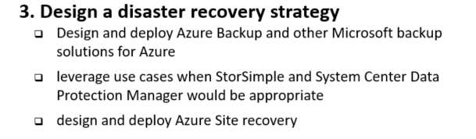
6 Manage, Monitory, Business Continuity

Slide 36
Azure Backup
Azure
Create virtual machines with fabric-level protection
Direct-to-cloud backup of files and folders
Built-in protection against ransomware
Economical cloud pricing with pay-as-you- go storage
Large scale, fast backups
Central storage of remote office backups without in-house management
Windows
VMs
App n
Scalable
Reliable
Encrypted
Secure
Production Environment
Windows
VMs
App n
On-premises Datacenter/branch Office

Slide 37
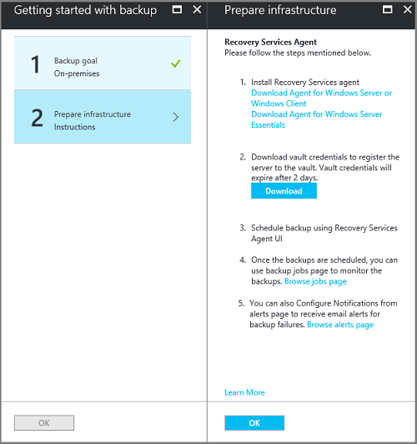
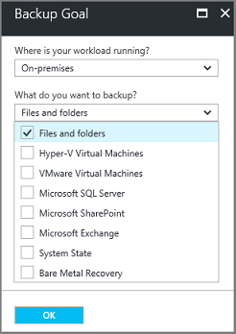
Deploy Azure Backup
Create a Recover Services Vault
Set storage redundancy for the vault (local or geo redundant)
Configure the vault (where and what is backed up)
Prepare the infrastructure
Install and register agent
Backup files and folders
Schedule job in the agent

Slide 38
Demo
Deploy Azure Backup
Create an Recovery Vault

Slide 39
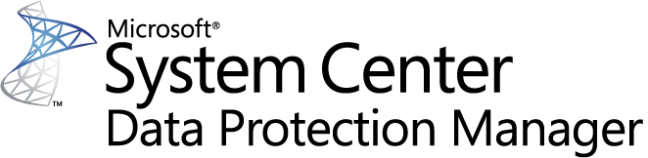




System Center DPM
Application-aware snapshots (VSS)
Full flexibility for when to take backups
Recovery granularity (all)
Can use Recovery Services vault
Linux support on Hyper-V and VMware VMs
Back up and restore VMware VMs using DPM
DPM Agent
VSS Requester
VSS Writer
VSS
VSS Provider
Notes:
Key terms:
Replica
Recovery Point
Initial Replication
Consistency Check
Synchronization
Express Full Backup
A protection group is a collection of data sources that share the same protection configuration. The protection configuration consists of the protection group name and settings for disk allocations, replica creation method, and on-the-wire compression

Slide 40
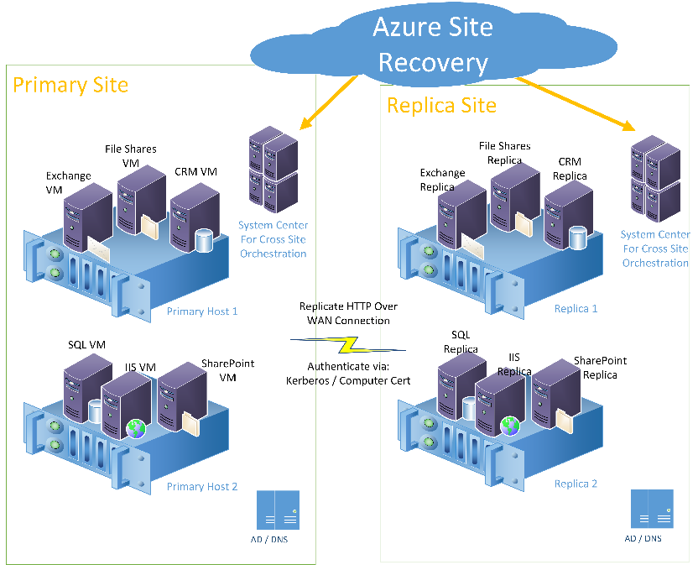
6.3.3 Site Recovery primary site and replica site
Azure Site Recovery monitoring a primary and replica site. The sites have workloads such as Exchange, CRM, IIS, SQL, and SharePoint running on hosts. Azure Site Recovery communication goes through System Center. System Center actually performs the orchestration of the cutover

Slide 41
6.4 Design Azure Automation

Slide 42
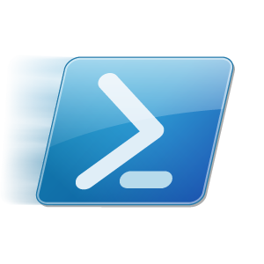

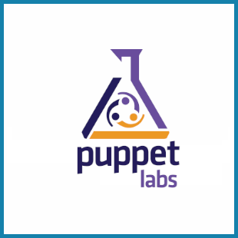
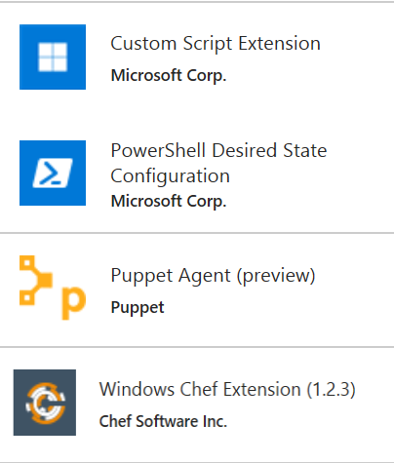
Azure Automation
Azure Automation
Runbooks
Chef Configure and Automate. Apply Fine Grained Permissions
https://www.chef.io/solutions/windows/
Puppet Can Configure and Manage Windows and Azure
http://puppetlabs.com/solutions/microsoft
Desired State Configuration
Make it So https://docs.microsoft.com/en-us/azure/automation/automation-dsc-overview
In the portal + New – Azure Automation
DevOps Enabler
Others, Docker, Ansible, SaltStack, etc.

Slide 43
6.5 Describe the use cases for Azure Automation configuration
Evaluate when to use Azure Automation, Chef, Puppet, PowerShell, or Desired State Configuration (DSC)

Slide 44
Azure Automation
PowerShell & PS Workflow Engines
Use your existing PS scripts
Checkpoint/Parallel if needed
Runbooks, Modules
Author PS, PSWF, Graphical runbooks
Gallery – Runbooks, modules
Extensibility, integration
Assets
Secure, global store for variables, credentials, …
Schedules
Jobs
Troubleshoot/audit via job history
PowerShell DSC
Configurations, Pull service
Node Management & Reporting
Hybrid Runbook Workers
Install on any machine
Secure, only outbound ports
Webhooks
URL to start runbook remotely
Integration
Azure Automation
Orchestrator
Hybrid Worker
SCO
SMA
Hyper-V
VMWare
OpenStack

Slide 45
PowerShell for automation
Automating repeatable, identical tasks
Creating resources such as VMs
Tasks that are very time consuming or prone to error

Slide 46
Desired State Configuration (DSC)
Install or remove windows roles and features
Running Windows PowerShell scripts
Managing registry settings
Managing files and directories
Starting, stopping, and managing processes and services
Managing groups and user accounts
Deploying new software
Managing environment variables
Discovering the actual confi guration state on a given node
Fixing a confi guration that has drifted away from the desired state

Slide 47
Lab Exercise
Create an OMS Workspace

